Slide 1
Introduction to the
CMC 2021 Standards
The ICMCI Professional Standards
Excellent Consultancy

Slide 2
A current view of our profession
A view of the future
PSC’s components of Excellence

Slide 3
A current view of our Profession
Every day thousands of management consultants provide good service to clients around the world
Our profession is one of the most successful but least regulated occupations
Exponential growth, elite status but … at times beset by scandal and critique
Difficult for Clients to evaluate quality and assess value
The consultancy process often lacks transparency
The financial rewards tempt consultants to oversell
Ethical Codes not universally adopted and tend to lack teeth
* Source - University of Bristol Policy Report – Can Management Consultancy be regulated?

Slide 4
A view of the Future
ICMCI Vision and Mission
To be a leader in the development of management consulting as a global profession that drives social and economic success.
To build the profile, recognition and influence of the profession and its practitioners globally
The ICMCI Professional Standards Committee
Development and maintenance of professional standards and guidelines that promote excellence in the consulting profession, including awards, certifications, qualifications and assessment processes.

Slide 5
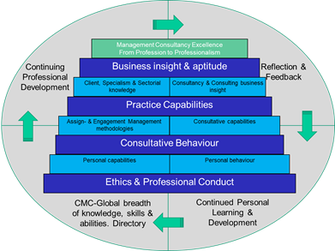
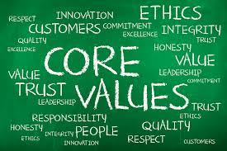
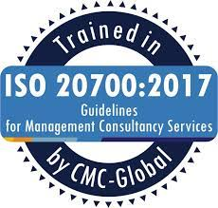
Three Components of Excellence for Management Consultants
Competence
Behaviour
Process

Slide 6
ICMCI Competence Framework
The cluster of related abilities, commitments, knowledge, skills and experience that a management consultant should demonstrate:
Business Insight and Aptitude
Consultancy Practice Capabilities
Consultative Behaviour
Ethics and Professional Conduct

Slide 7
ICMCI Code of Conduct
Serving the interests of:
Clients
Society
Organisation
Colleagues
The Profession

Slide 8
ICMCI ISO 20700 Checklist
Best Practice for application of ISO 20700 Standard
Comprehensive – covers everything to be considered in a management consultancy assignment
Universal – for all types of client and assignment
Flexible in application to different Client situations
Beneficial for Consultants and Clients
Common Framework for Clients and Consultants
Prevents misunderstandings between Client and Consultant
Evaluation Aid for Client to assess value of consultancy

Slide 9
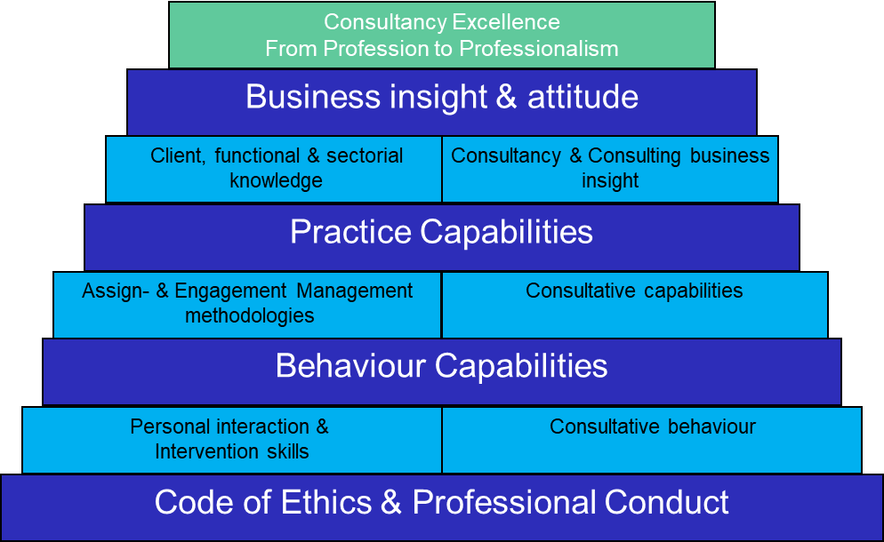
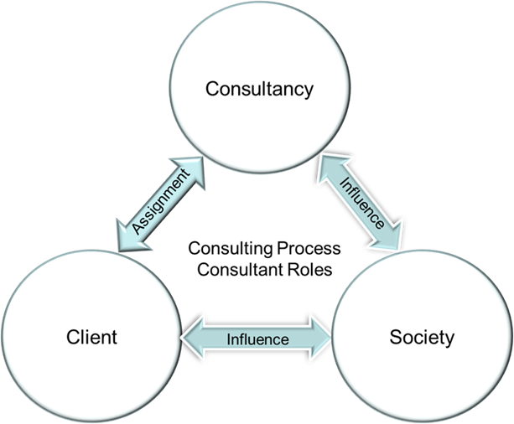
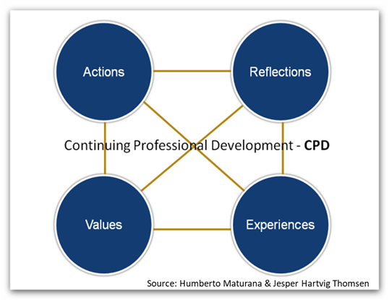
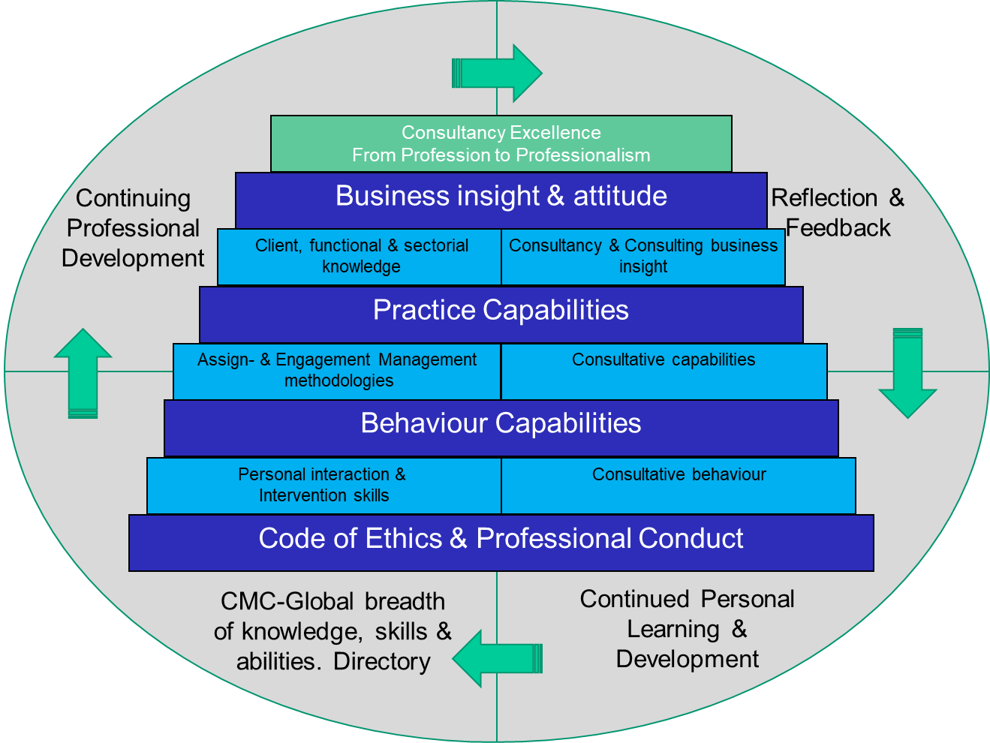
ICMCI CMC Competence Framework
Why
What
The CMC Competence Framework specifies the cluster of related abilities, principles, commitments, knowledge, skills and experience that a management consultant should demonstrate in practice in order to successfully complete an assignment, independently and unsupervised.
We believe that we can advance our profession, both individually and collectively, by embracing this Competence Framework Reference. We also believe that this Competence Framework Reference will assist us in making wise decisions, particularly when faced with difficult situations where we may be asked to compromise our integrity.
The Competence framework is divided into 4 levels (the dark blue).
We strive to describe good principles of values, attitudes and behaviors and we describe good requirements for Competence for Business and Consulting Knowledge, Skills and Experience.
How
How
Competence Framework
Requirements and ranging for Foundation, CMC and Profession Leader
Continuing Professional Development
Competence Framework Assessor Guide
Assessment criteria’s for passing CMC

Slide 10
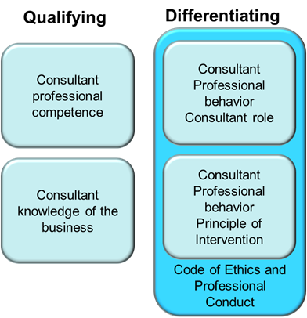
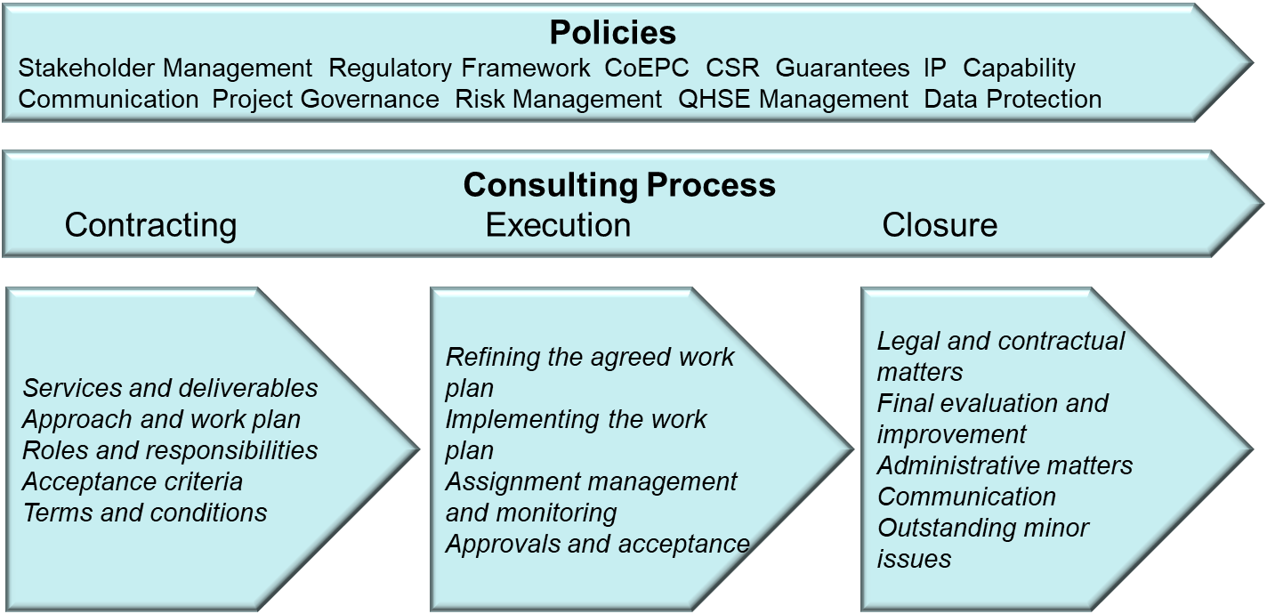
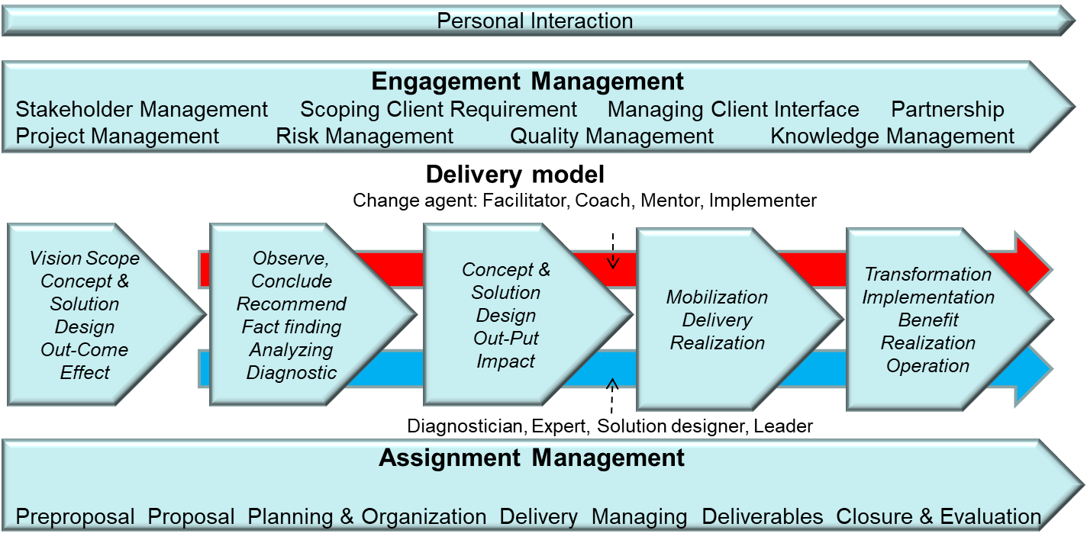
Background Competence Framework
Background
Why
We are using the interpretation of the wording Consulting this way:
Consultancy covers the business that You are a part of
Consulting is the processes and disciplines that handles the deliveries
Consultant’s roles are the delivery forms when you express the tasks in the assignment.
You as a person we name MCSP (Management Consultant Service Provider) when You practice consultancy
The Code of Ethics and Professional Conduct describes the rules of engagement that we have as MCSP’s in the global management consultant community. On top of the Code of Ethics and Professional Conduct we add principles and competence standards for behaviour, practise and attitude.
Beliefs
Intention
Thoughts
Attitude
Actions
Results
Impact
How
How
ICMCI CMC competence Framework version 3.0 is base on the old version 2.0, ISO 20700 and many other CoC’s and Competence Frameworks. The diagram below illustrates the standard ISO 20700
The diagram below shows the practical implementation with Competence Framework approach in Consulting and Consultant roles.

Slide 11
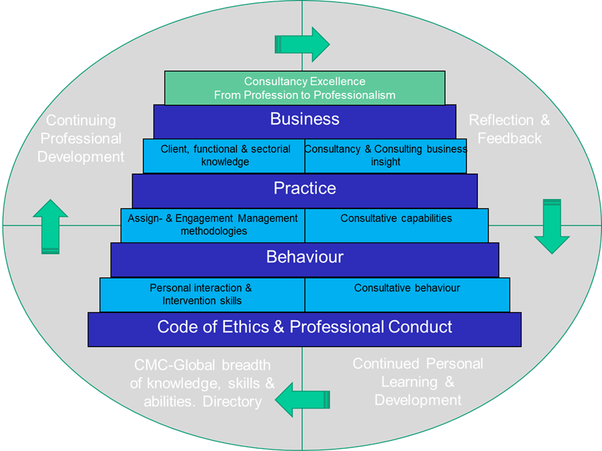
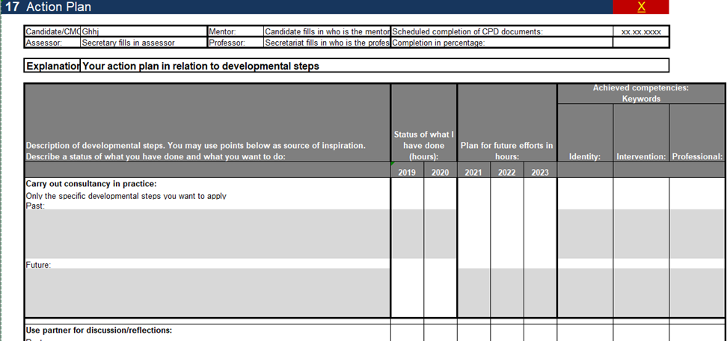
Continuing Professional Development (CPD)
Why CPD and moving in the ranging
How
CPD ensures your capabilities keep pace with the current standards of others in the same field.
CPD ensures that you maintain and enhance the knowledge and skills you need to deliver a professional service to your customers, clients and the community.
CPD ensures that you and your knowledge stay relevant and up to date. You are more aware of the changing trends and directions in your profession. The pace of change is probably faster than it has ever been. If you stand still, you will be left behind, as the value of your knowledge and skills becomes out-dated.
CPD helps you to stay interested and interesting. Experience is a great teacher, but it does mean that we tend to do what we have done before. Focused CPD opens you up to new possibilities, new knowledge and new skill areas.
The Certification committee manages the candidates through the three years period and check for progress, quality and awareness.
The candidate has assigned a mentor from the CMC Fellow program, and they work together for securing both quality in the material delivered to the certification committee and (especially) Continuing Professional Development of the candidate
The importance of continuing professional development should not be underestimated – it is a career-long obligation for practicing professionals.
How

Slide 12
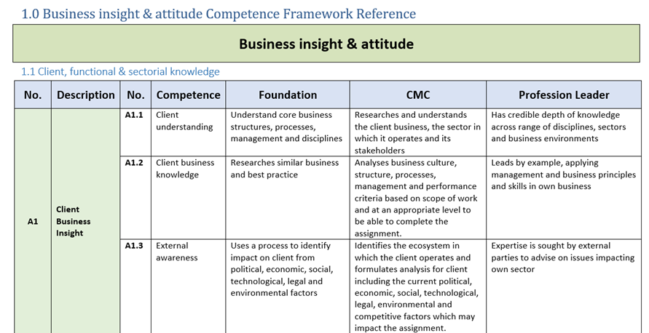
Competence Framework
What
Where
Client, functional & sectorial knowledge
Content Structure
Competencies has a main description and additional sub-competences for different level. See next slide.
Competencies is shown as requirement to consultant as behavior competence and principles and as requirement as relations between consultancy, client and society.

Slide 13
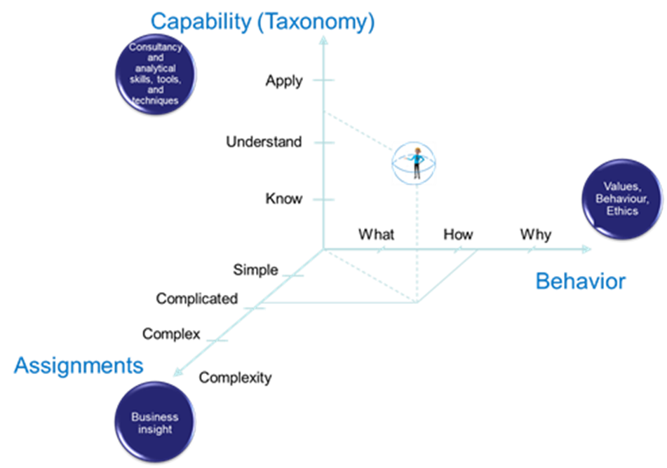
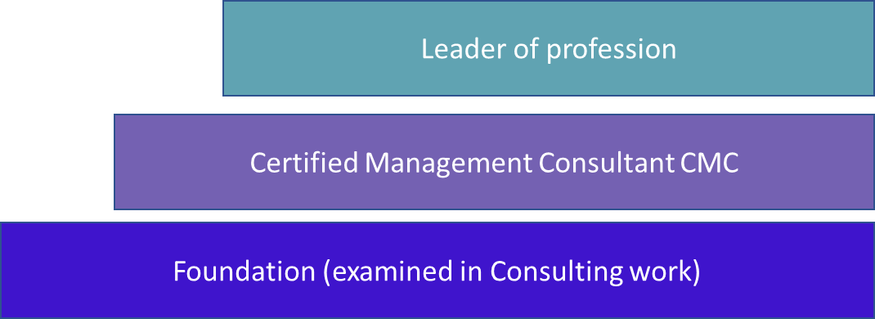
Competence Framework
What
How
Development of Consultant maturity
These CMC Range Statements the cluster of related abilities, principles, commitments, knowledge, skills and experience that a management consultant should demonstrate in practice in order to successfully complete an assignment, independently and unsupervised.
It also defines the maturity in the profession (Foundation, CMC, Profession leader). A consultant must reach the CMC Level before CMC can be awarded.
How
The level of maturity for the Profession Leader designation is based on additionality from the CMC designation below – i.e. the Profession Leader designation requires fulfilment of the requirements of the CMC designation in addition to its own requirements.

Slide 14
Competence Framework
What
Where
Client, functional & sectorial knowledge
A1
A2
A3
Content
Content
A.1 | Client Business Insight | A1.1 | Client understanding
 |  | A1.2 | Client business knowledge
 |  | A1.3 | External awareness
A.2 | Functional and Sectorial Knowledge | A2.1 | Functional and sectorial knowledge and experience
 |  | A2.2 | Knowledge of functional and sectorial drivers, trends and future challenges
A.3 | Consultancy differentiator – adding value | A3.1 | Add value to the client by practicing professional and ethical behaviour
 |  | A3.2 | Client development

Slide 15
Competence Framework
What
Where
Consultancy & Consulting business insight
B1
B2B3
Content
Content
B.1 | Consultancy & Consulting Business Insight | B1.1 | Consultancy business knowledge
B.2 | Professional Business Competence | B2.1 | Professional attitude and behaviour as consultant
B.3 | Consultancy & Consulting Competence Development | B3.1 | Continuing development of consulting and consultancy

Slide 16
Competence Framework
What
Where
Assign- & Engagement Management methodologies
C1
C2
C3
Content
Content
C.1 | Assignment Management (Consulting Process) | C1.1 | Assignment Management processes
 |  | C1.2 | Focus on the content of the Assignment Management processes
C.2 | Building and Sustaining Relationship (Engagement Management) | C2.1 | Focus on relationship and engagement
C.2 |  | C2.2 | Building an approach and working culture (Process & Integration Management)
C.3 | Personal Engagement | C3.1 | Takes the lead in assignment and engagement

Slide 17
Competence Framework
What
Where
Consultative Capabilities
D1
D2
Content
Content
D.1 | Consulting Process Techniques | D1.1 | Appropriate use of tools and methodologies
 |  | D1.2 | Ability to craft a feasible and effective solution
 |  | D1.3 | Transformation Capabilities
D.2 | Personal Capabilities and Relationship | D2.1 | Understanding the context, process and result of consultancy tools
 |  | D2.2 | Relationship and Networking

Slide 18
Competence Framework
What
Where
Personal interaction & Intervention skills
E3
E1
E2
Content
Content
E.1 | Leadership | E1.1 | Managing Yourself
 |  | E1.2 | Managing others
 |  | E1.3 | Managing assignment, output and outcome
E.2 | Personal behaviour and interaction | E2.1 | Takes responsibility
 |  | A2.2 | Shows respect
E.2 |  | E2.3 | Makes decisions fairly by acting impartially and objectively
 |  | E2.4 | Acts with honesty
 |  | E2.5 | Shows integrity
E.3 | Intervention capabilities | E.3.1 | Manages interventions to achieve successful outcomes that add value to the client

Slide 19
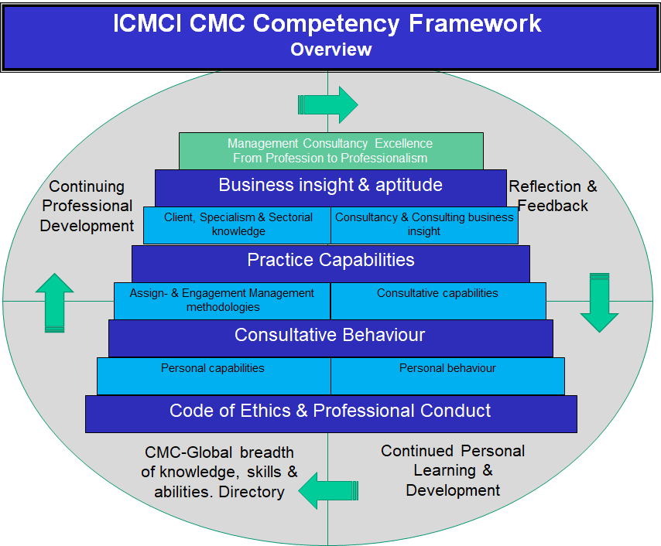
3 Components of Excellence for Management Consultants
Competence
Behaviour
Process

Slide 20
Thank you!
Nick Warn – Chair of PSC
www.cmc-global.org

