Slide 1
ICMCI Annual Meeting of Delegates
Amman, October 2023
ICMCI Risk Management System

Slide 2
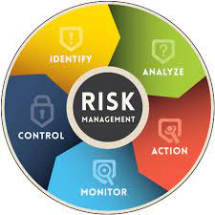




ICMCI Risk Management System - overview
Why have a Risk Management System?
Gergana Mantarkova, Ruggero Huessler,
Alan Blackman, Reema Nasser, Nick Warn
The RMS
Risk Management Manual
Risk Management Form
Risk Register
Implementation Plan
Responsibilities
Risk Officer
Board
Committees & Task Forces
Member Institutes
Example of Risk Control - Code of Communication
Notes:
Normal requirement for good governance; Assure protection of ICMCI reputation and resilience; Project management ; IQA Accreditation Body
Task Force - Regular meetings with individual work in between - thanks
Manual
Objectives, Scope of Application, Responsibilities – Risk Officer
Policy and Procedures
Risk Identification, Risk Analysis and Measurement, Risk Management and Control
Risk Monitoring, Risk Reporting
Appendix 1 Risk Assessment Template, Appendix 2 Risk Register
Responsibilities
RO – Manage system, approve RMFs, Maintain RR, Report to Board
Board – Risk Appetite, Monitor and review, delegate actions
Comm & TF – Identify and report risks, control and mitigate
Insts – Implement own RMS using principle of equivalence

Slide 3
ICMCI Risk Management System – Risk Management Form Example

Slide 4
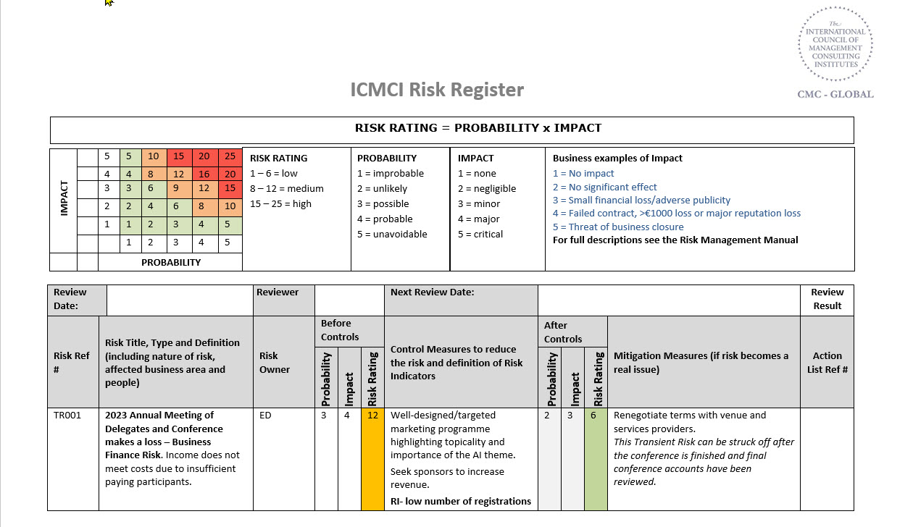
ICMCI Risk Management System – Risk Register Example

Slide 5
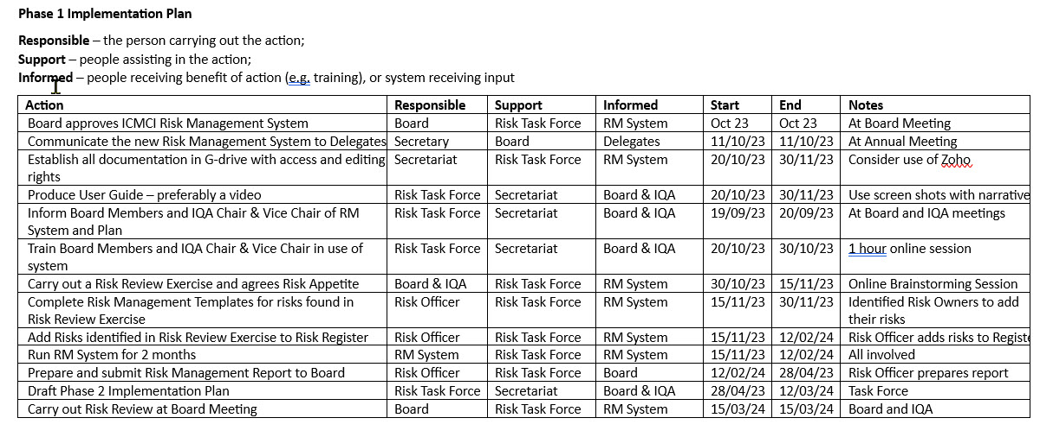
ICMCI Risk Management System – Manual

Slide 6
ICMCI Risk Management System – Code of Communication
ICMCI Code of Communication
All communication made by any ICMCI entity will be Positive, Factual, Accurate, Informative and Value-adding.
ICMCI communications will avoid any defamatory statements.
ICMCI communications will avoid any content that is discriminatory in terms of race, colour, religious or political belief, gender identity, sexual orientation, marital status, age, or ability.
ICMCI written communication will avoid any statement that renders ICMCI liable to allegations of libel, and in verbal communication will avoid any statement that renders ICMCI liable to allegations of slander.
ICMCI communications will comply with General Data Protection Regulations (GDPR) and any other applicable legal requirements.
Communication with the media
Communication in a crisis

Slide 7
Thank you!
شكراً
cmc-global@cmc-global.org
www.cmc-global.org

